Slide 1
INTERNAL PITCH
Data Identity
Platform
From Control Tower → Ontology → Autonomous Data Operations.
A machine-readable identity layer for every enterprise data asset — subjective (what it is) × objective (who uses it).
◉ Control Tower
→
○ Ontology
→
○ Autonomous
dependencies
meaning
action
today
Q2 – Q3
Q4
April 2026 · Leadership Review

Slide 2
WHY THIS MATTERS
2 / 12
Five wounds hiding under today's dashboards.
Ordered by blast radius — from individual frustration to organisational risk.
⏱
PERSONAL · DAYS
🔁
TEAM · MONTHLY
🧭
CROSS-TEAM · QUARTERLY
Incident triage burns hours
Source-reuse debt is invisible
Business-concept drift
Every schema hiccup spins up a war room. Days, not minutes, to answer "what breaks if…".
The same upstream table, pulled three ways by three teams. Triple the pipeline cost, three forks of the metric.
Six answers to "what's our inventory?". Each team quietly locks in its own. Nobody owns the reconciliation.
🔒
COMPLIANCE · YEARLY
🎲
LEADERSHIP · ONGOING
PII lineage is tribal knowledge
Migrations are dice rolls
Who copied customer PII, to which dashboard, through which view? Auditors want a paper trail we can't print.
Kill-decisions ship on gut feeling. Rollbacks cost weeks and quiet trust with every silent failure.

Slide 3
THE CATEGORY GAP
3 / 12
Not a catalog. Not observability. Not a semantic layer.
Each existing category answers one third of the question. We join them.
Existing category
Core question it answers
Scope
Catalog
"What exists?"
Discovery of assets + ownership.
Observability
"Is it broken?"
Freshness, anomalies, pipeline health.
Semantic layer
"How do I compute it?"
Modelled business logic, query-side.
We join them.
"What does it mean,
and what happens when it breaks?"
Meaning × Impact
unified · live.
The other three remain underneath us — we don't replace them, we make them answerable to the business.

Slide 4
PHILOSOPHY
4 / 12
“No one is truly gone
while they're still remembered.”
A data asset lives by the same rule.
SUBJECTIVE
OBJECTIVE
What it is, knows, can do
Who uses it, how it drifts
owner · definition · flavor
constraints · skills it enables
consumers · incidents · KPIs
drift signals · trust score
Every skilled engineer has these two sides too. When they leave, the subjective side walks out —
unless the graph has already learned to remember.
We build the memory layer — and because it's a graph, AI agents can walk it, not just humans.

Slide 5
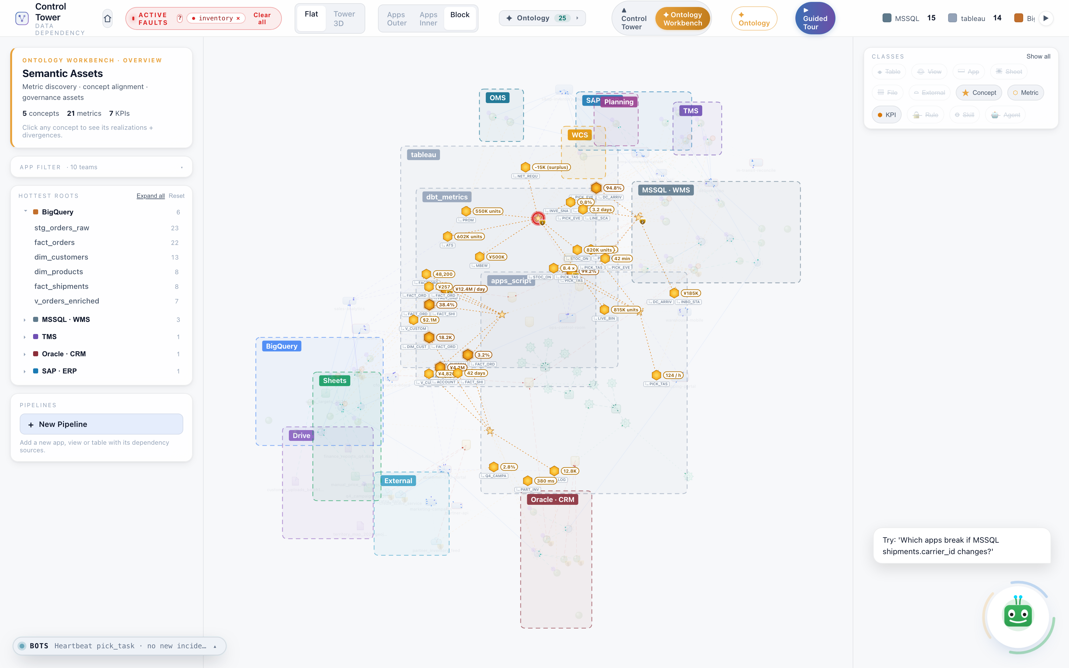
THE DOOR · KAI
5 / 12
One conversation. Every answer the graph already knows.
Kai is the AI concierge on top of the memory layer — the single entry to everything that follows.
What Kai does for a human
• Routes every question.
Natural language → exact subgraph. Voice or keyboard, same pipeline.
• Orchestrates the bot fleet.
When a governance / incident / discovery bot files a finding, Kai wakes with a remediation card pre-filled.
• Keeps humans in the loop.
Human approves, Kai writes an Action node — every step is auditable.
• Same door for agents.
Whatever a human asks, a downstream agent can ask the same way — the graph answers both.

Slide 6
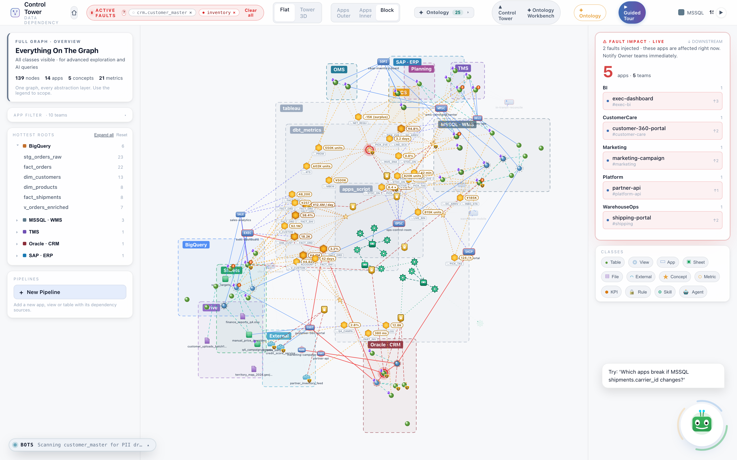
WOW 1 · BLAST RADIUS
6 / 12
Any fault. Every downstream app. Three seconds.
hours of war-room
→
seconds of visibility
wiki-spelunking
→
Slack channels surfaced
"who owns this?"
→
every owner team listed
silent schema churn
→
fault injection replays any change

Slide 7
WOW 2 · REUSE ADVISOR
7 / 12
Before you open a new pipeline — we show who's already doing it.
One warehouse table
What Kai does about it
wms.fact_pick_task
1
Ask: "do we already track pick accuracy?"
any language the team uses
is currently fetched by three different tools
2
Kai ranks existing metrics.
⚠ 3
owner + channel returned in one shot
3
Canvas badges the source table with ⚠ N fetchers.
reuse debt visible on the map
Ops → hourly extraction job
Data Platform → nightly batch model
WMS Analytics → live dashboard query
4
Result: triple pipeline cost → single owner.
slot spend · metric forks · both drop

Slide 8
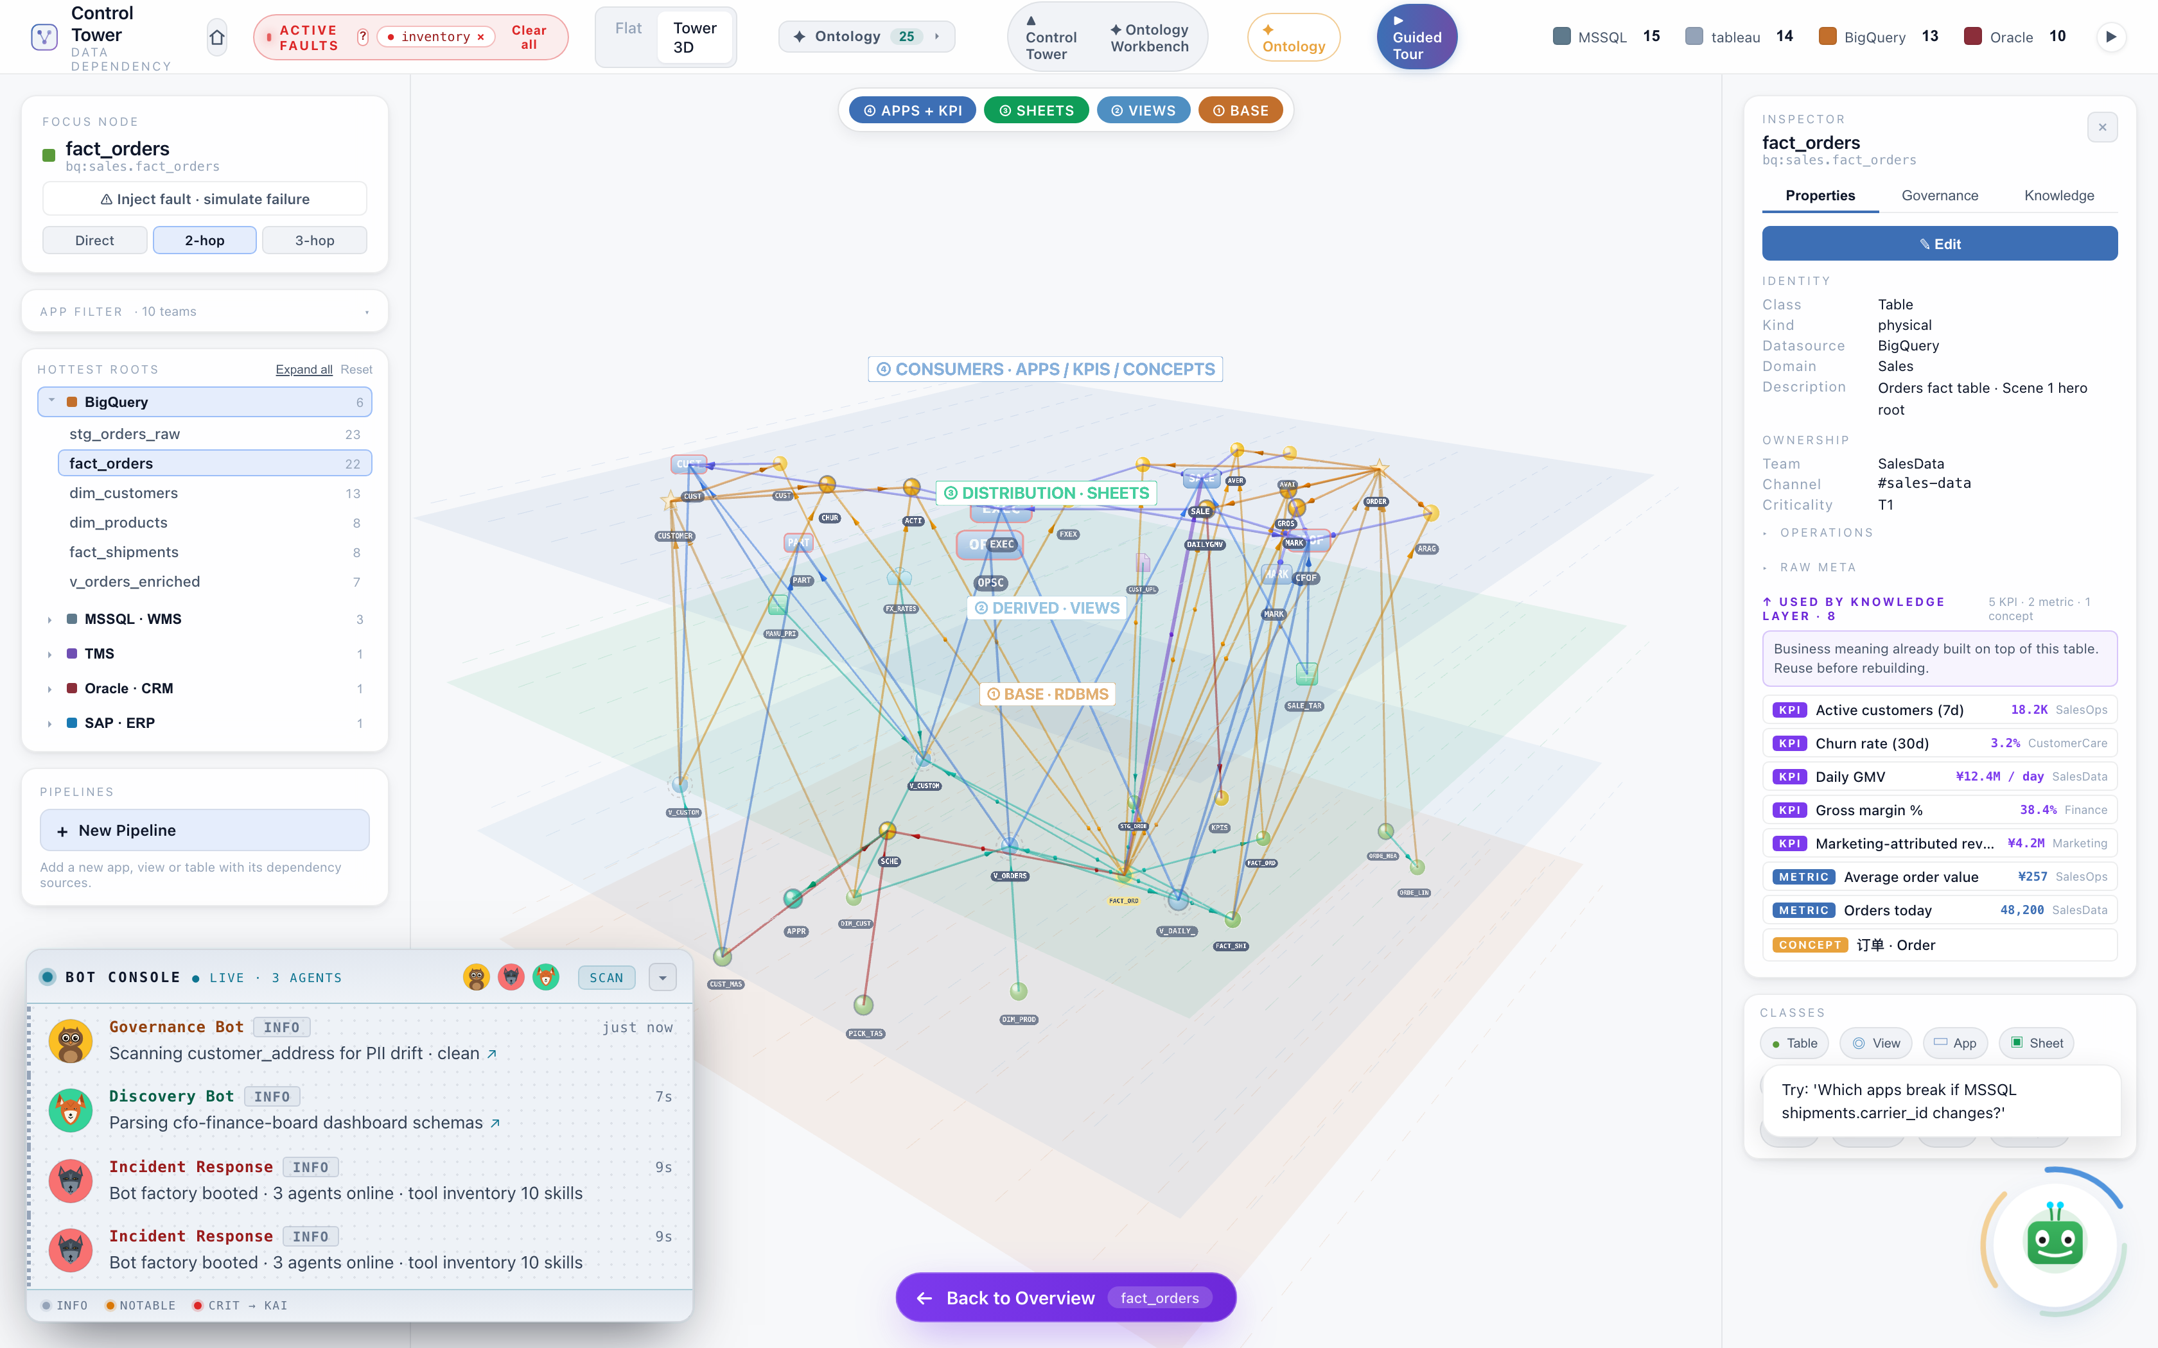
WOW 3 · GOVERNANCE
8 / 12
Policies live in the graph. Bots enforce them. Humans approve.
Three changes in the operating model
Rules are edges.
PII policy, concept-drift threshold, schema-change SLA — all modelled as live graph edges, not wiki pages.
Bots propose.
Governance, incident, discovery — each bot watches its slice, drafts remediation, and sends a card to Kai.
Humans approve.
Every accepted action becomes a node in the graph. The audit trail is the graph itself.
Autonomy is tunable.
Each rule sets its own threshold — propose-only, auto-execute, or escalate. Leadership owns the dial.

Slide 9
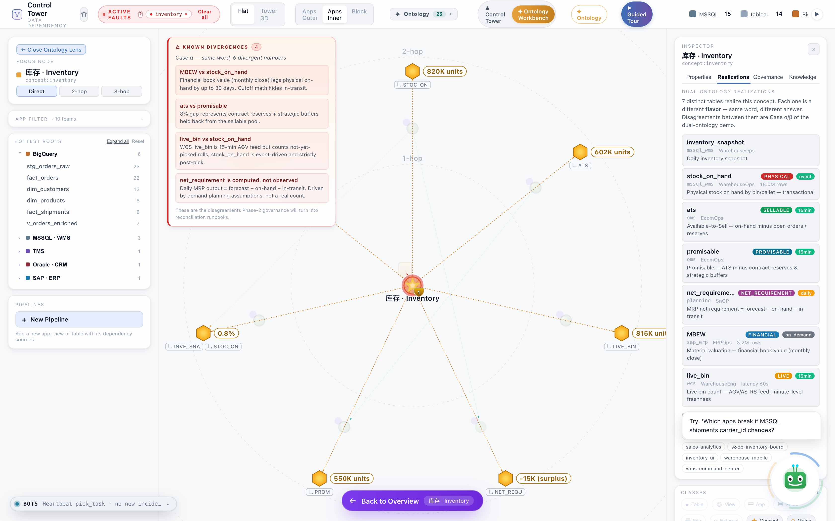
WOW 4 · IDENTITY IN ACTION
9 / 12
"What's our inventory?" has six correct answers. The graph holds all of them.
What the shot proves
Philosophy → product.
The concept inventory sits in the centre. Each branch is one real team's flavor — purchase, warehouse, finance, in-transit — each with its own owner and unit.
When two realizations drift beyond policy, the incident is filed at the concept level — not on a random dashboard.
This isn't a chart. It's a query AI agents can walk — the visual is just the projection.

Slide 10
ARCHITECTURE
10 / 12
Graph-native by design.
So agents can reason over it — not just so humans can look at it. The visualisation is a byproduct.
CONVERSATION LAYER
Ask the graph anything.
natural language → subgraph · voice-in · proposal-out · human approval rail
AUTONOMY LAYER
Agents propose. Humans decide.
bot fleet · skill catalogue · action audit · autonomy gates per rule
IDENTITY LAYER
Every asset has two sides.
dual-ontology · concept realizations · rules as typed edges · trust score
PERCEPTION LAYER
Continuous sensing across every source.
metadata ingestion · runtime signals · change feeds · cross-source stitching
No specialised databases, no bespoke clusters, no new infrastructure required to pilot.
Implementation is ours. The contract is yours.

Slide 11
IMPACT & EVOLUTION
11 / 12
Qualitative leaps today. A three-act evolution ahead.
WHAT CHANGES · TODAY
Incident triage
days
→
minutes
Reuse debt
3× pipeline cost
→
one owner per metric
Concept reconciliation
silent drift
→
policy-level incident
New-hire ramp
weeks
→
days
EVOLUTION · ADDITIVE, NEVER REPLACING
PHASE 1 · TODAY
PHASE 2 · Q2 – Q3
PHASE 3 · Q4
Control Tower
Ontology
Autonomous
Wow 1 · 2
Wow 3 · 4
Governance loop
App · Table · View · live dependencies and blast radius.
+ Metric · KPI · Concept · Rule. Identity layer goes live.
+ Skill · Agent · Action. Bots execute, humans govern.

Slide 12
THE ASK
Run a six-week pilot
with one pilot squad.
WHAT WE BRING
WHAT WE NEED
HOW WE MEASURE
WHAT YOU GET
✓
The running Control Tower on your data
→
Read-only access for one squad
◎
Triage time · week 1 vs week 6
★
Go / no-go decision at week 6
✓
Multi-source connectors, read-only
→
Two engineer-hours per week
◎
Reuse-debt audit baseline
★
A reusable identity layer for the squad
✓
Weekly demo + roadmap review
→
One lead-hour per week
◎
Concept-drift incidents raised
★
Data to scope the next phase
Runs on existing infrastructure. Zero new licences. Zero new environments.
Data Identity Platform · April 2026

